Slide 1
How far can we trust published TESS periods?
Universe of Binaries, Binaries in the Universe
Telč, Czech Republic, September 7-11, 2019
Zdeněk Mikulášek, Marek Skarka,
Department of Theoretical Physics and Astrophysics, MU Brno

Slide 2
Introduction
TESS data – one of the most popular source of information about variable stars, including their periods. Unprecedented accuracy and lots of data make TESS periods highly credible.
However, the majority of such periods (+ their errors) are mere artifacts of the method used to determine them and, at best, are just an estimate.
TESS data suffers from two shortcomings that significantly impair the results of the periodic analysis with standard tools. The data show terrible instrumental trends and are obtained only in non-standard short time intervals of 27 days (with a break), comparable with the lengths of periods themselves.
The following analysis, based on the simulations of the cyclic light curve resembling rotating chemically peculiar stars with a period of 2.7 days, show possible pitfalls of TESS data.
Why simulation and not straight TESS data? Because the conclusions will be applied to all short-term observations of variable stars.

Slide 3
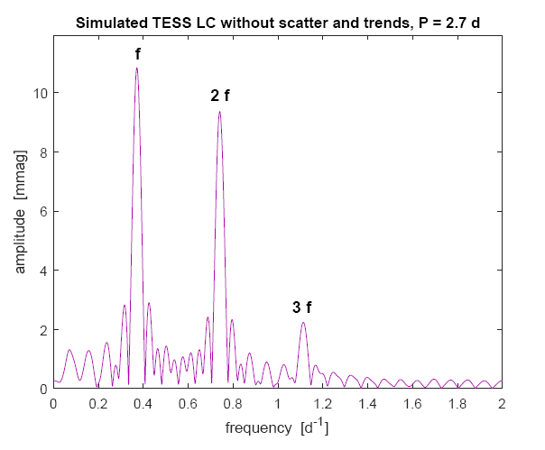
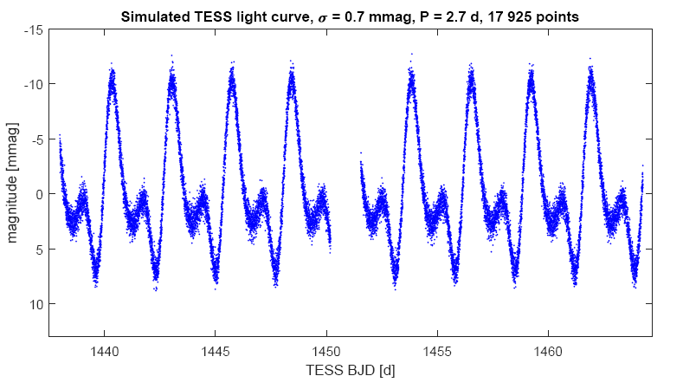
17 925 simulated observations, without any trend, third order harmonic polynomial, scattered by Gaussian noise, σ = 0.7 mmag, semi-amplitude: 10 mmag. The only period – 2.7 d – typical for CPs.
The specification confirmed the Lomb-Scargle periodogram in the amplitude modification.

Slide 4
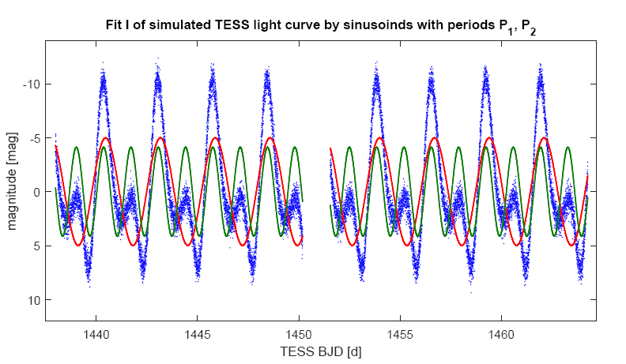
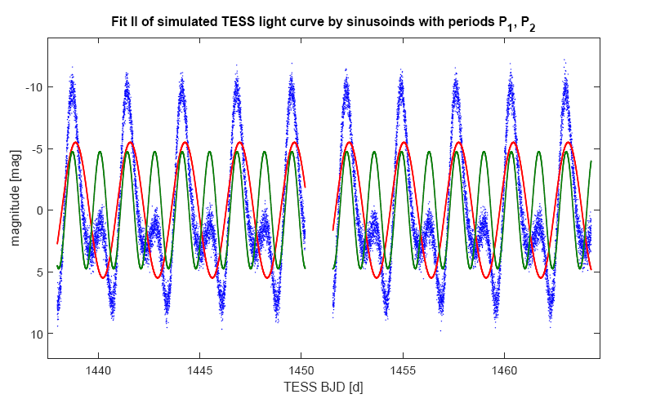
Role of the initial phase on the period determination
Surprising: P₁ = 2.7070(10) d, P₂ = 2.6977(8) d. Why such a difference?
The same results give other simple period finders. The reason – all are based on the same assumption – LCs are more or less sinusoids which amplitudes and the periods can be pinpointed by the simple least square method with the period as one of the parameters.
The fit can find for the fundamental frequency or higher overtones. Because of the data time interval is limited, resulting periods are generally different. Which is correct? No one! P₁ > P > P₂ .
At the top the ‘periods’ are functions of the LC shift in time now – P₁ = 2.6958(10), P₂ = 27021(7), so P₁ < P < P_{2.} The ‘periods’ are not period themselves, but only parameters found by regression. The reason – the admitted models of light curves fragrantly differ from the LC reality.
The found periods are then complex functions of the LC shift. The amplitude of the uncertainty due to this fact is simply shocking.

Slide 5
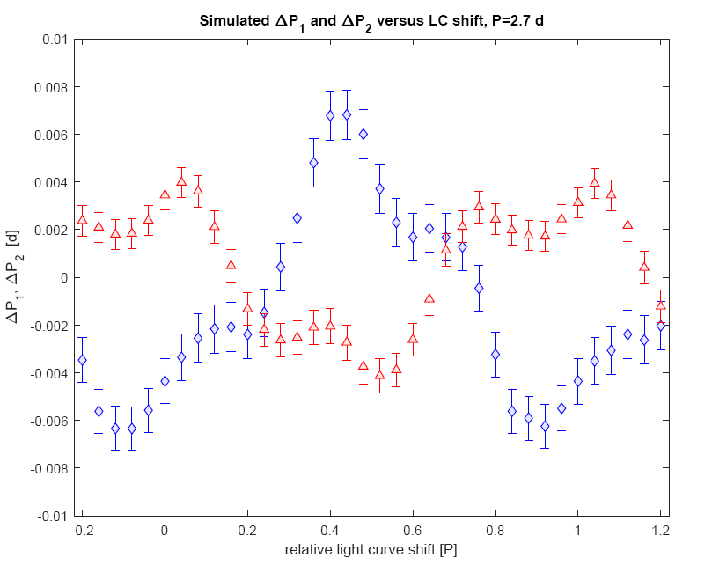

Slide 6
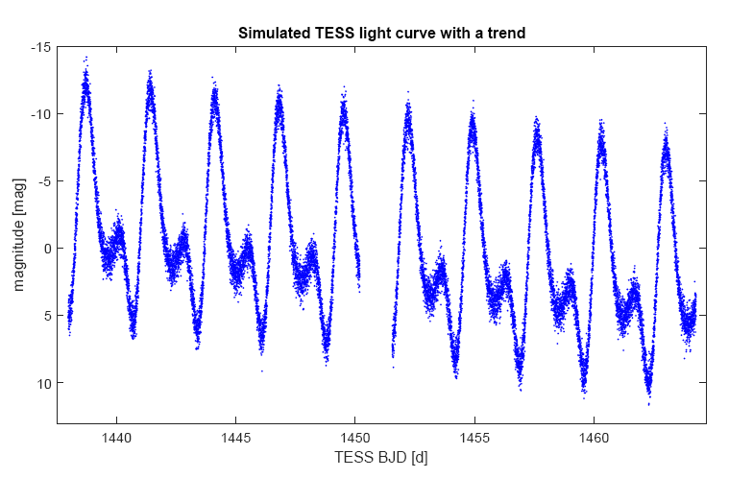
Influence of the LC trend
Instrumental trends in TESS data – quite common phenomenon. Linear, quadratic, more complex. They have a completely devastating effect on period determination.

Slide 7
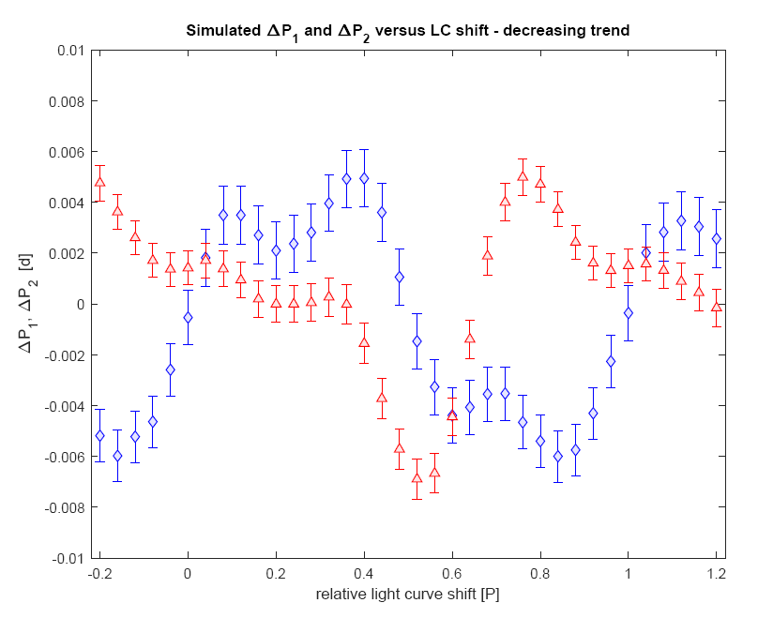

Slide 8
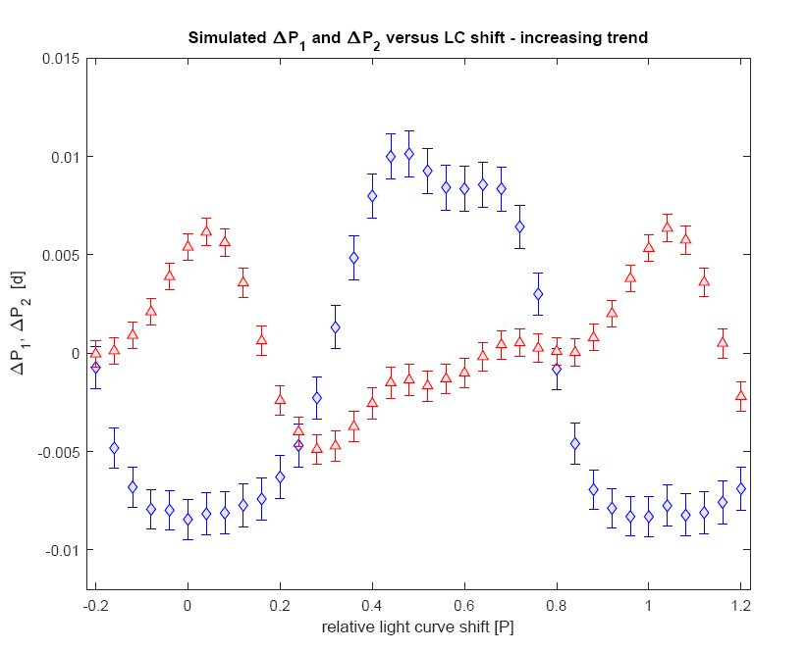

Slide 9
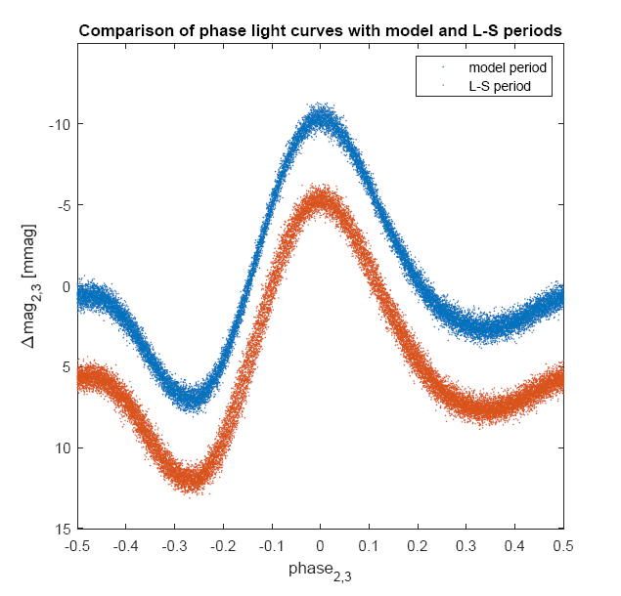
Models of LC and trends
$F\left(a,b,P1\right)=a\cos\left(\frac{2πt}{P1}\right)+b sin⁡\left(\frac{2πt}{P1}\right)$ - basic harmonic
$F\left(c,d,P2\right)=c\cos\left(\frac{4πt}{P2}\right)+d sin⁡\left(\frac{4πt}{P2}\right)$ - first harmonic
3 (4) parameters cannot express reality.
Phenomenological model of the real light curve – (3-rd or higher harmonic polynomial) + model of trends in LC (at least linear function – two terms) and period P as a parameter.
8 parameters, at least. Phase light curve and trend models should be tailored to the actually observed LC.
Modern tools such as chi-square approach, robust regression, bootstrapping, etc. can be used to find parameters (including period-periods) and estimate their uncertainties.

Slide 10
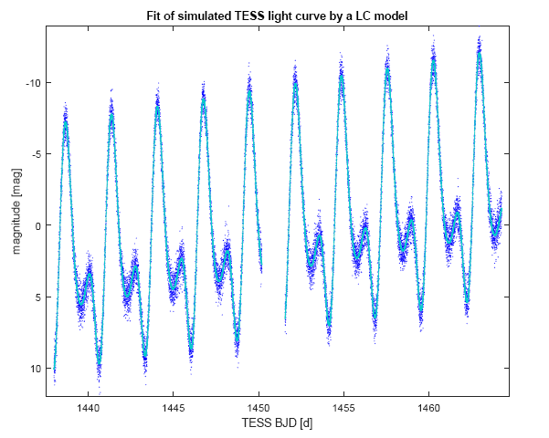

Slide 11
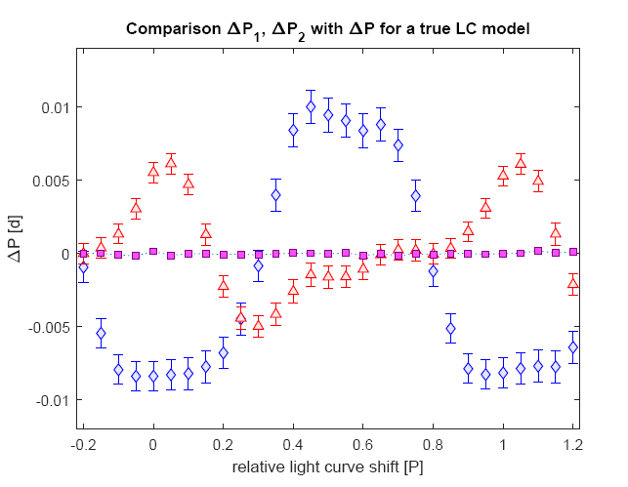

Slide 12
Conclusions
Short-term observational series corrupted by instrumental trends are not the optimal observational material for determining periods.
Using standard methods we make serious errors both in the determination of the period and in the estimation of the uncertainty of this determination.
In the periodic analysis of TESS data, the differences between the found period and the actual period are so great that we are not able to correctly establish observations that are only a few years away.
A rigorous solution to the problem is to move to realistic models of light curves, including a true description of phase curve/curves as well as instrumental trends.
Only then will we use the information potential of short-term observation sets.

