Slide 1
Beyond DC and MCMC: alternative algorithms and approaches to fitting light curves
Angela Kochoska, Kyle Conroy, Kelly Hambleton, Andrej Prša
10 September 2019
Universe of Binaries, Binaries in the Universe
Telč, Czech Republic

Slide 2
Motivation
Fitting with phoebe 2 (phoetting)
  python offers so many options – which ones should we focus on?
    Minimizers?
    Samplers?
    Machine learning?
Do we really understand our methods?

Slide 3
DISCLAIMER

Slide 4
Backstory: The phoetting challenge
What?
  Fitting a synthetic light curve with added noise
Why?
  We know EXACTLY what the parameter values are
Fixed parameters:
  Period
Parameters to adjust:
  q, incl, r1+r2, r2/r2, Teff1, Teff2/Teff1, esinw, ecosw, pblum, l3

Slide 5
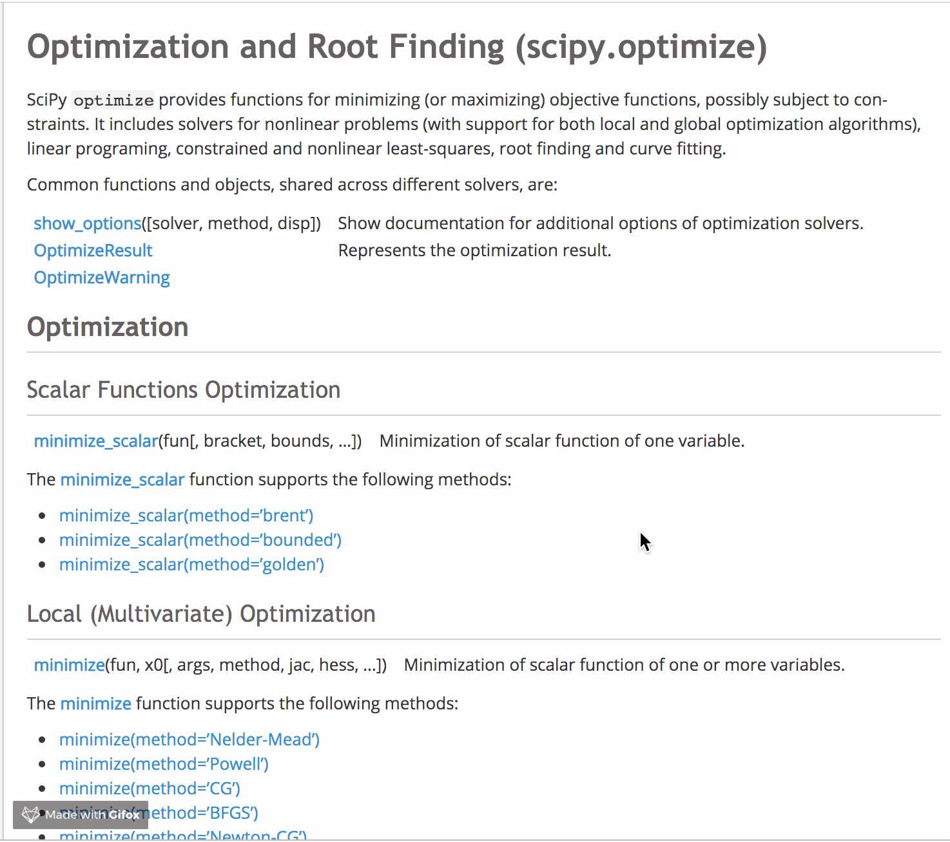
The FITTING PLAYGROUND:MINIMIZERS
What can we use?
  scipy.optimize has a whole zoo of methods already implemented and tested
Are they all good for fitting EBs?
  probably not.
https://docs.scipy.org/doc/scipy/reference/optimize.html

Slide 6
PHOETTING LC AND MINIMZERS
Fixed parameters
  q
  Teff1
  pblum
  l3
Fitted parameters
  incl
  esinw & ecosw
  r1+r2 & r2/r1
  Teff2/Teff1
Choice of minimizers
  Nelder-Mead downhill simplex (local)
  Powell’s method (local)
  L-BFGS-B (local)
  Differential Evolution (global)
Two runs with different initial points
  close to global minimum
  (Relatively) far from global minimum

Slide 7
Phoetting lc and minimizers

Slide 8
Phoetting lc and minimizers

Slide 9
Phoetting lc and minimizers

Slide 10
TAKEAWAYS from the minimizers test
There is no perfect minimizer
  Due to the complexity of our model
Global is better than local
  Con: global minimizers take much longer than local minimizers

Slide 11
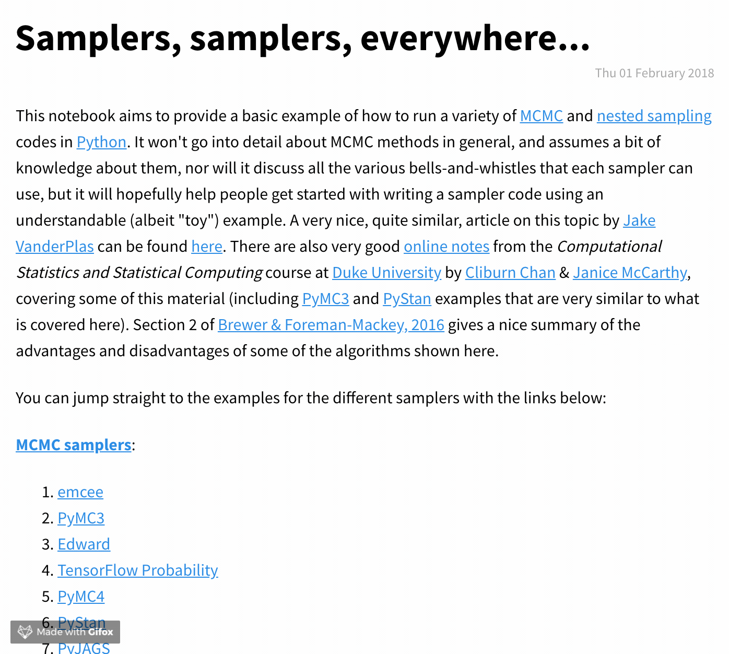
The fitting playground: SAMPLERS
Is MCMC the Holy Grail?
  Yes, If you’re already close to the global minimum
Are there samplers that can be used for wide parameter space exploration?
  Nested sampling, Hamiltonian MC?
http://mattpitkin.github.io/samplers-demo/pages/samplers-samplers-everywhere

Slide 12
Phoetting lc and SAMPLERS
Treating MCMC as search algorithm/minimizer
(a work in progess…)
BAD MCMC

Slide 13
Phoetting lc and SAMPLERS
Sampling in a tight ball around the global minimum
(a work in progess…)
GOOD MCMC

Slide 14
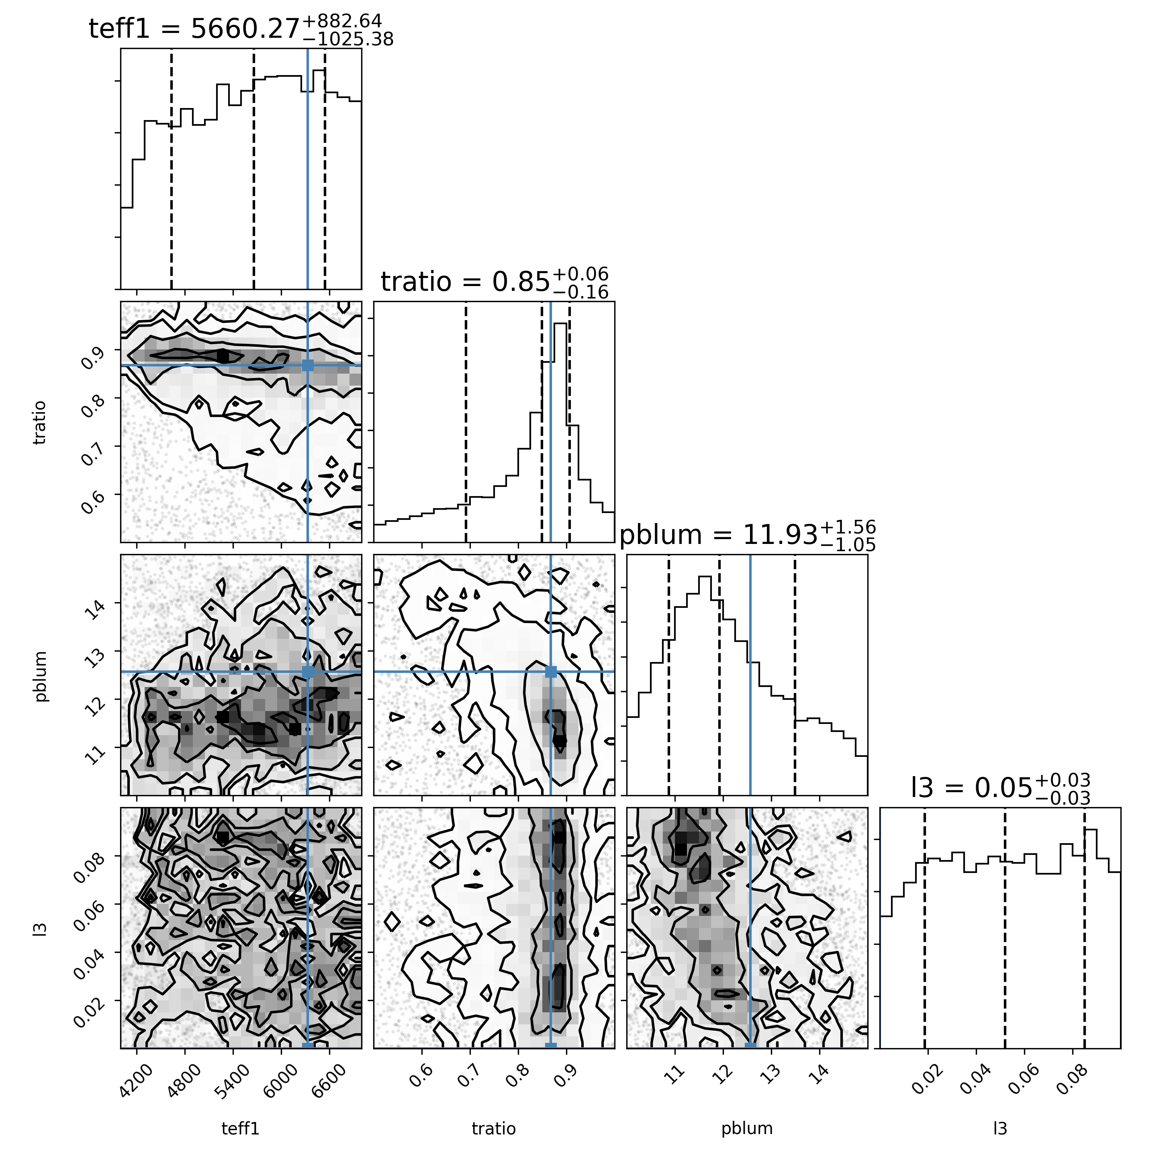
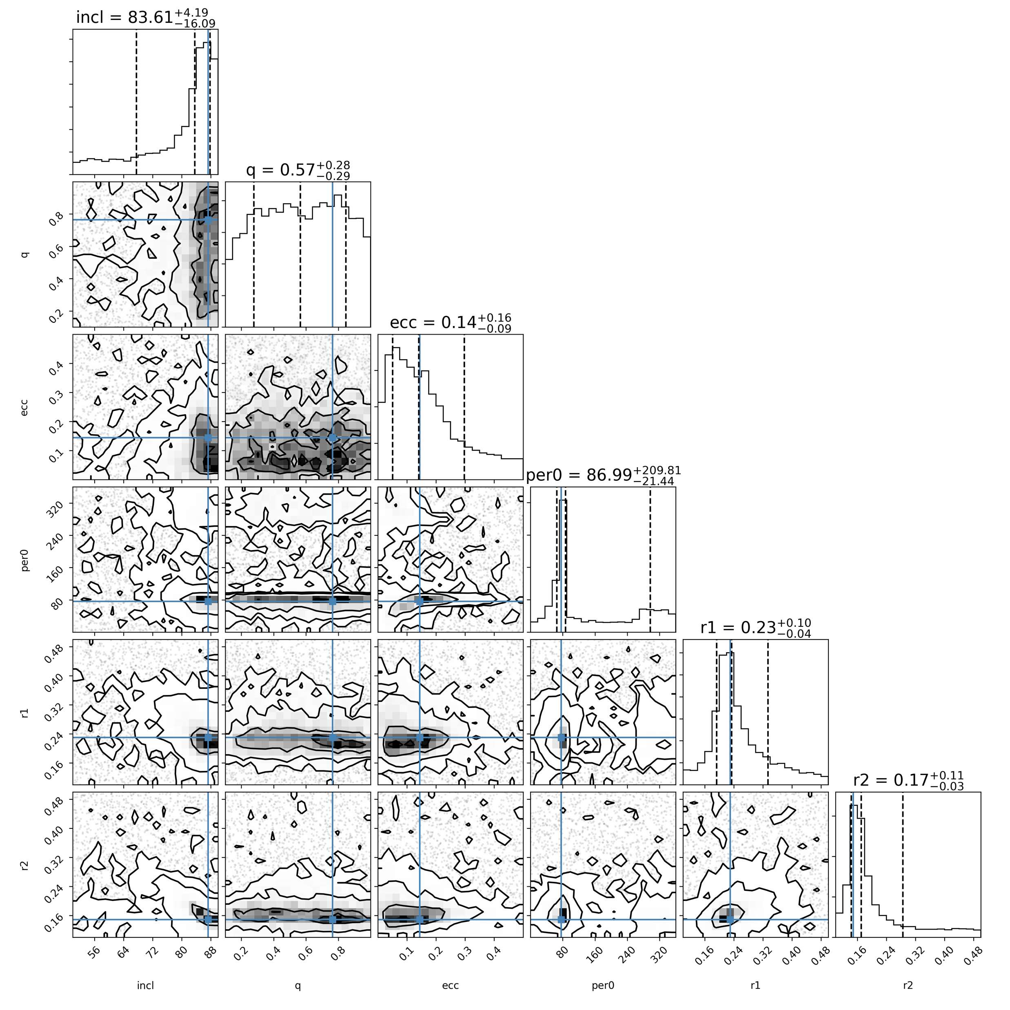
Phoetting lc and SAMPLERS
Parameter space exploration with nested sampling
(a work in progess…)

Slide 16
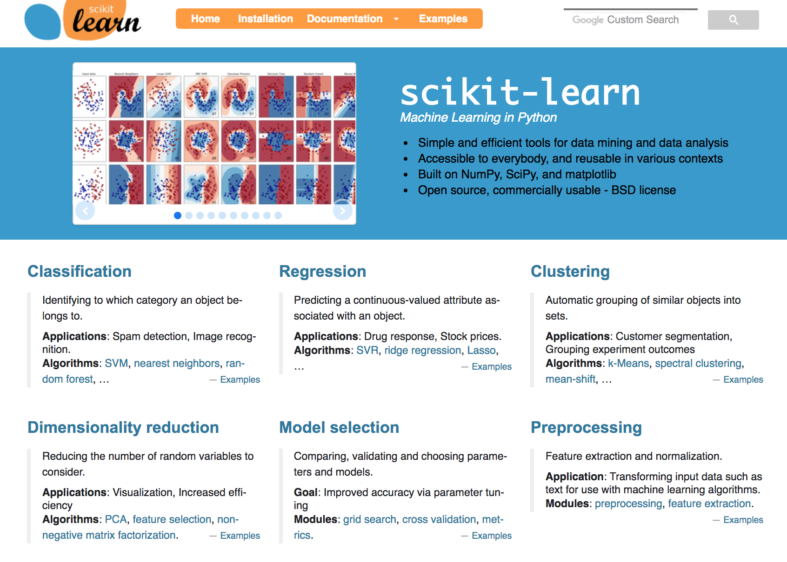
The fitting playground: MACHINE LEARNING
Large datasets and simultaneous fitting of multiple light curves
  Can we reliably estimate the parameter values or approximations of the global minimum using ML methods?
https://scikit-learn.org/stable/

Slide 17
Phoetting lc and machine learning
A simple approach:
  Build a database of precomputed light curves
  Compare your light curve to the database and extract parameters from the database parameters of the nearest neighbors
  Phoetting LC: 100 nearest neighbors from a database of 100,000 synthetic LCs
  Compute parameter values from distance-weighted mean of NNs
  Compute parameter ranges from min/max values among the NNs

Slide 18
Phoetting lc and machine learning
 | min | dw-mean | max | true
q | 0.5117 | 0.764 | 0.993 | 0.765
incl | 80.915 | 85.925 | 89.996 | 87.3
r1+r2 | 0.323 | 0.397 | 0.489 | 0.3817
r2/r1 | 0.558 | 0.678 | 0.798 | 0.6394
Teff1 | 5013 | 6053 | 6992 | 6332
T2/T1 | 0.771 | 0.879 | 0.962 | 0.8678
esinw | 0.014 | 0.145 | 0.246 | 0.1379
ecosw | 0.009 | 0.031 | 0.052 | 0.03339
pblum | 10.17 | 11.75 | 13.29 | 12.5664
l3 | 0.001 | 0.045 | 0.100 | 0

Slide 19
ML– not always so SIMPLE
Purely synthetic test of the parameter space of contact binaries
  A database of 100,000 CBs in random values spanning the whole physical space of [q, FF, incl, T2/T1]
  A test set of 100 CBs with known parameter values
  NN (with filtering) to extract values

Slide 20
ML– not always so SIMPLE

Slide 21
ML– not always so SIMPLE

Slide 22
ML– not always so SIMPLE

Slide 23
ML– not always so SIMPLE
Dimensionality reduction to visualize the parameter space configuration →
3D t-SNE map of the parameter space

Slide 24
ML– not always so SIMPLE
Filtered database on similar values of incl and T2/T1

Slide 25
summary
Takeaways from the phoetting challenge
  The “best” way to model EBs remains the careful, hands-on approach. However, the era of big data is urging us to explore automated methods
  We need to understand our models and methods in order to properly interpret the results we get
  There are a plethora of methods available to us, but not all suitable for all problems
    Global optimizers > local optimizers
    Grid search can get us close to the range of the global minimum (but not always)
    Some samplers (i.e. nested sampling) are good for parameter space exploration in a wide range around the minimum
    Only use MCMC when you’re confident enough you’re close to the global minimum!
This is just the beginning!
https://github.com/gecheline/fitting_playground

Slide 26
THANK YOU FOR YOUR ATTENTION!

Slide 27
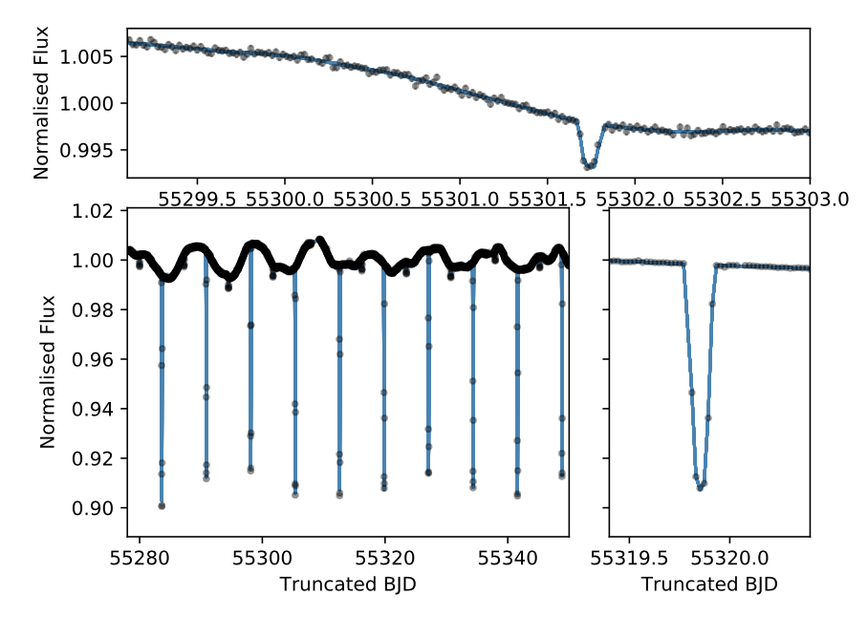
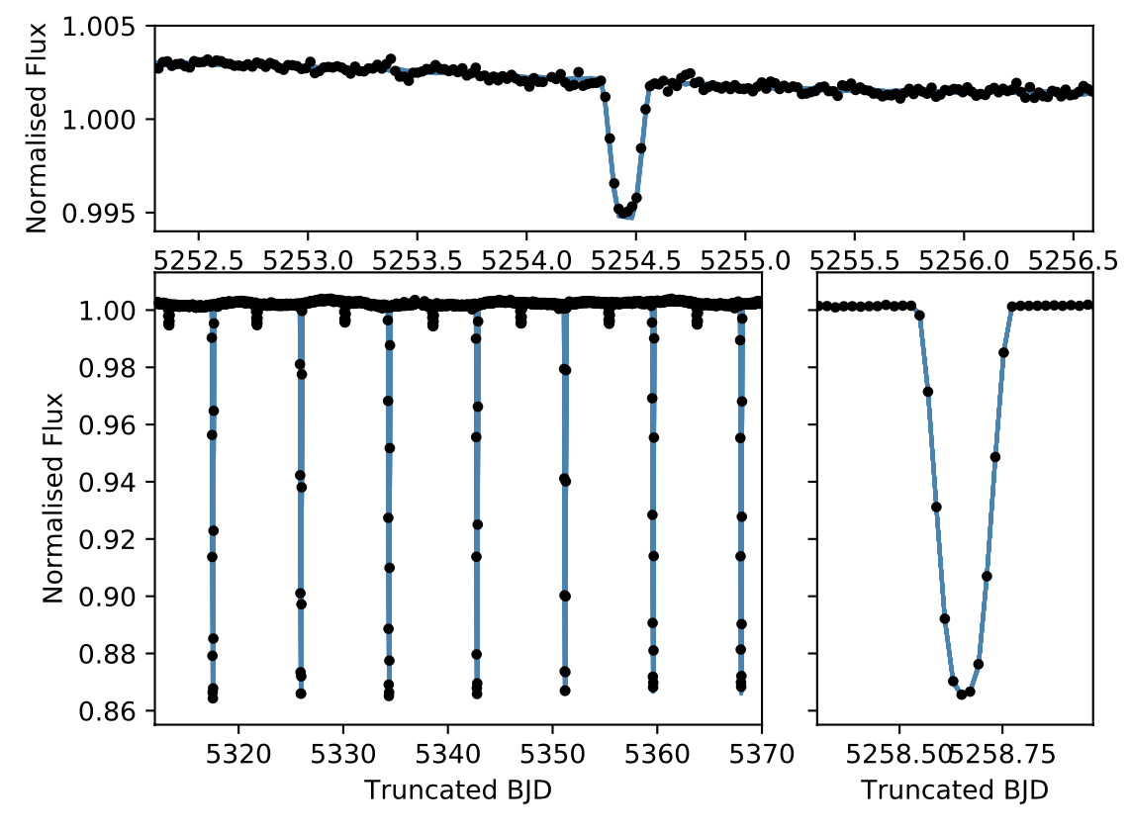
ADDED COMPLICATIONS: NOISE Modeling
In all of the mentioned fitting approaches we are assuming white noise, but that is not always the case
  Fitting with noise modelling: Gaussian processes
Mahadevan et al. (submitted)

Slide 28
THE RESULTS

